Slide 1

Pizza Sales Analysis
Domain: Data Analytics / Sales Insights
Tools Used: SQL, Tableau, MS Excel
Techniques: Data Cleaning, EDA, Dashboarding
Presented By: K.Sathvika

Slide 2
Introduction
This project analyzes pizza sales data to understand customer buying behavior, revenue performance, and product popularity.
Using SQL for analysis and Tableau for dashboards, it highlights key sales trends to support datadriven decisions.

Slide 3
Objective
To identify best-selling and least-selling pizzas.
To analyze monthly and weeky sales performance
To find most preferred pizza sizes and categories
To understand customer ordering trends
To support business decisions like inventory planning and staff scheduling

Slide 4
Tools Used
SQL: Data Cleaning, aggregation & sales analysis
Tableau: Interactive dashboards & visual insights
MS Excel / CSV: Data storage, preparation & import

Slide 5
Dataset Description
The dataset contains detailed pizza sales records from a restaurant
Includes order details, pizza types, prices, quantities & order timestamps
Total Data Size: 48,620 rows & 12 columns
Columns include order ID, pizza name, category, size, quantity & total price
Used for identifying sales trends, top products & revenue performance

Slide 6
Key Columns in Dataset
order_id: Unique identifier for each order
order_date & order_time: When the order was placed
pizza_name & pizza_id: Specfic piza details
pizza_category: Type of pizza (Classic, Veggie, Supreme, ect.)
pizza_size: Available sizes (S, M, L, XL, XXL)
quantity: Number of pizzas ordered
unit_price & total_price: Price per pizza & total billing amount
pizza_ingredients: Components used in each pizza

Slide 7
Data Cleaning
Checked for missing or null values in key columns using SQL
Removed duplicate records to ensure data accuracy
Verified and formatted dates & times for consistency
Cleaned dataset ready for analysis and visualization
Check missing values
SELECT SUM(CASE WHEN order_id IS NULL THEN 1 ELSE 0 END) AS missing_order_id FROM pizza_data;
Remove duplicated
SELECT DISTINCT * FROM pizza_data;

Slide 8
Exploratory Data Analysis (EDA)
Sales Trends
Analyzed overall sales performance and daily order volumes.
Monitored month-wise revenue and order count growth.
Identified peak sales days and weekly order distribution.
Evaluted weekend vs weekday demand patterns.
Detected seasonal or festive spikes in pizza ordering.
Observed overall sales trends to support business forecasting.

Slide 9
Product & Customer Insights
Determined highest-selling pizzas based on revenue and quantity.
Compared category performance (Classic, Supreme, Veg, Non-Veg).
Analyzed pizza size preferences and customer buying patterns.
Identified top revenue-generating pizza combinations.
Measured order frequency during lunch and dinner peak hours.
Highlighted best-performing items for marketing and upselling.

Slide 10
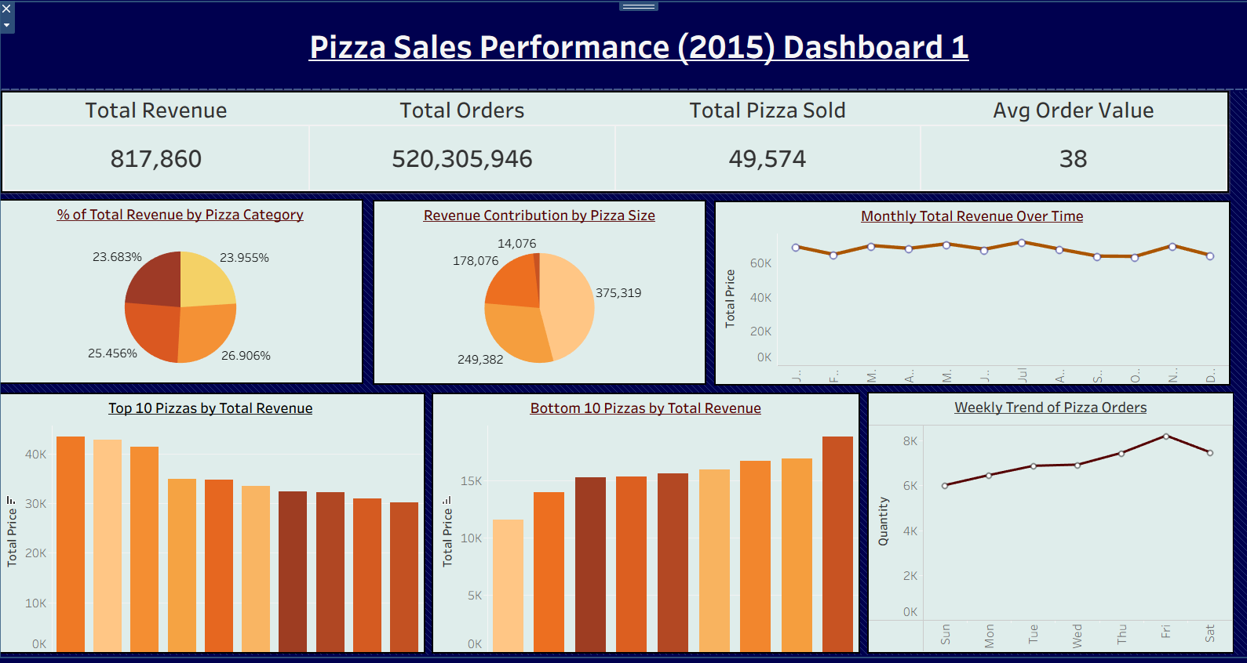
Dashboard 1: Sales & KPI Overview

Slide 11
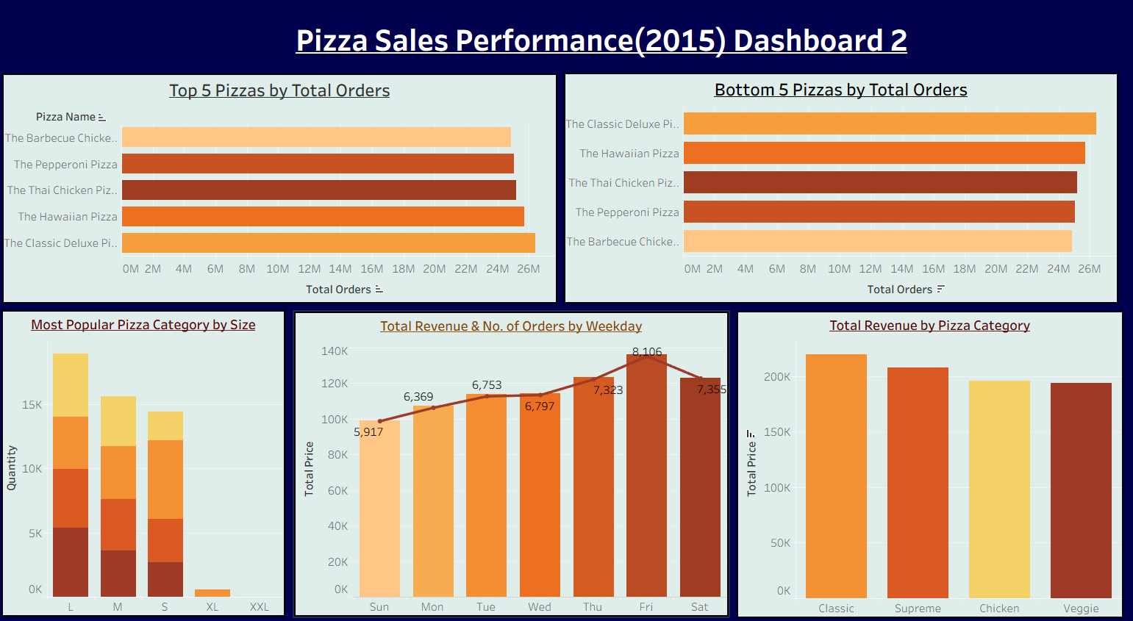
Dashboard 2: Category & Order-Level Overview

Slide 12
Key Insights from Dashboards
Classic & Large -size pizzas generated the highest revenue
Top-selling pizzas contribute majarity of total orders
Weekend days show peak customer demand (Friday & Saturday)
Medium and Large pizzas are most preferred by customers
Least selling pizzas indicate menu improvement opportunities

Slide 13
Conclusion
Project successfully analyzed pizza sales using SQL & Tableau.
Identified best-selling pizzas, categories, and popular sizes.
Sales trends showed higher orders on weekends and mid-year months.
Insights help in menu improvements, stock planning & staffing decisions.
Strengthend skills in data analysis, SQL querying & dashboard creation.

Slide 14
THANK YOU

